Slide 1

Improve your short-term memory
Project 0,<html, css, & JavaScript>
Mohamed tawfik

Slide 2
How can I do that?
I made a game using three technologies (Technical requirements)
HTML
CSS
JavaScript
Layout of a web page
Styling HTML document
Functionality

Slide 3
HTML
JS
CSS
Styling
Welcome
Exit
Structures of the game
Functions
Functionality

Slide 4
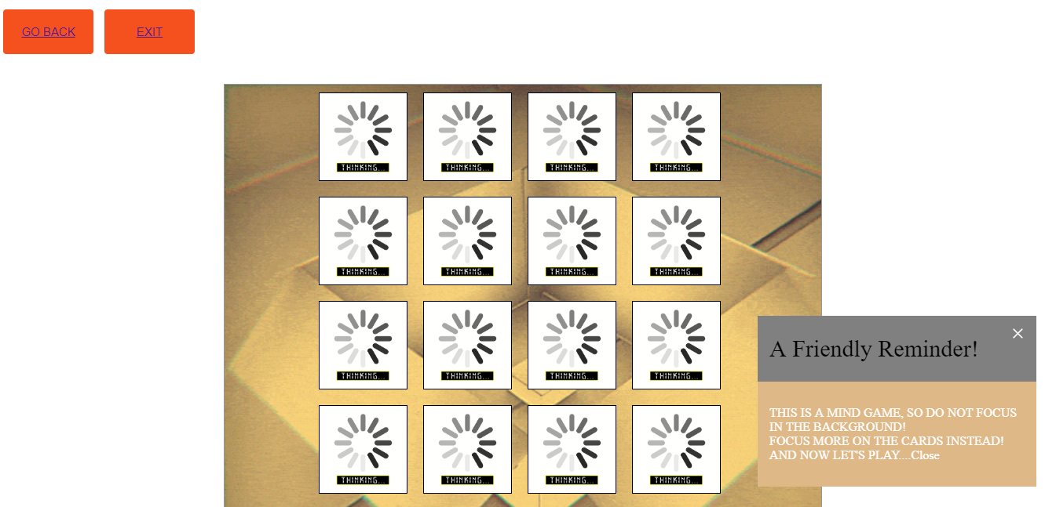
S0, what’s the logic for this game?
The user is given number of cards and needs to match all the cards that have the same value.
Comparing the 2 cards were chosen, if they didn’t have the same value, as a result return to the original position.
In case, the cards the user selected matched, they must remain facing up, till all card are matched.
If the user would like to play again, cards will shuffle so we give the user time to memorize

Slide 5
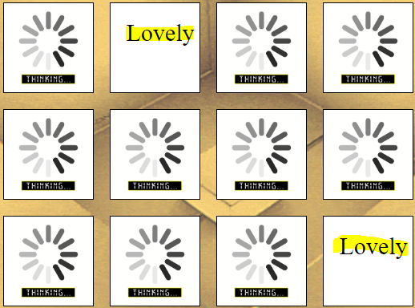
If cards are matched they must remained flipped

Slide 6
References
https://app.revature.com/dCourses
https://www.w3schools.com/html/
https://www.w3schools.com/css/
https://www.w3schools.com/js/
https://developer.mozilla.org/en-US/docs/Web/API/SpeechSynthesisVoice

Slide 7

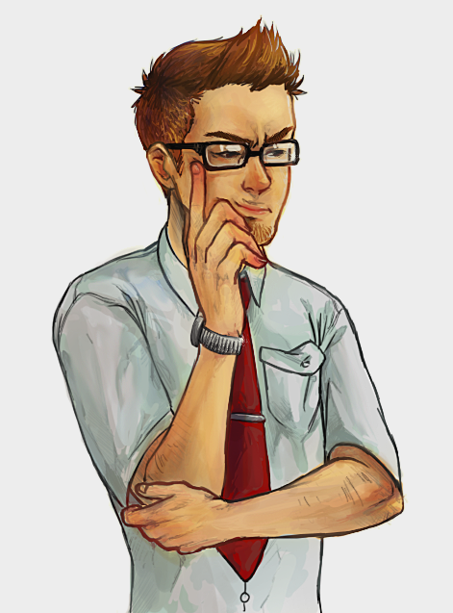
Is there any question?

